Slide 1
Foto
Seungho Yang,
Kevin Trochez,
Binbin Xuan,
Yun Ye,
Gregory Szymanski
Professor: Vincent Miller

Slide 2
Agenda
Strategy
How we implemented the strategy (slides 4 - 5)
Expected results / Projection (slides 6 - 7)

Slide 3
Strategy
Low-Cost Leadership Strategy
Low price
2. Market share

Slide 4
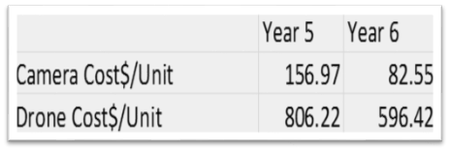
Costs decrease
Production cost
Reducing the image sensor size, LCD display screen, etc.
Labor cost
Decrease Assembly Quality Incentive, Attendance Bonus,etc.
Notes:
(to increase market share)
the more important price-related consideration affecting a company’s unit sales/market share is the extent to which its wholesale selling price to retailers in each region is above/below the industry (all-company) average in the region.
AC Camera : 225 -> 200
UAV Drone :
Lowered production cost

Slide 5
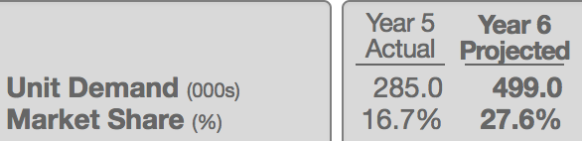

Marketing
Retailer Support Budget
Bigger company’s retailer network in a region
Stronger brand exposure leads to larger market share
Sales Promotion
Enhancing competitive edge over rivals offering smaller discounts.
Search Engine Advertising
Draw consumers to our website
Notes:
Retailer Support budget
A portion of the retailer support budget is also used to support the trips of company marketing personnel to visit the stores of high-volume retailers and work with store managers/clerks in expanding/improving the footprint of the company’s POP displays.
the bigger a company’s retailer network in a region, the stronger is its brand exposure to camera shoppers and the better chance it has to win sales and market share.
Sales promotion
So long as all other competition- related factors are, on balance, close to equal among the rivals in a region, companies offering bigger sales promotion discounts gain a sales-enhancing competitive edge over rivals offering smaller discounts.
Search Engine advertising
spend on search engine advertising to help draw shopper traffic to their website (where a big percentage of drone sales are transacted

Slide 6
Expectations
Increased market share
3%- 8% increase (depending on the region)
Lower P/Q Rating
Much shorter-than-average warranty
Surpassed investor expectations for year 6
EPS: $3.68
ROE: 48.7%

Slide 7
Projected Forecast - Net Profit
North America Europe-Africa Asia-Pacific Latin America
Net Profit
Increase around $55 millions
Net Revenues | $ Per Unit $166.40 | $ Per Unit $166.40 | $ Per Unit $166.73 | $ Per Unit $166.73
Unit Demand (000s) | 499.00 | 414.60 | 370.6 | 277.40
Operating Costs | $118.47 | $121.72 | $122.40 | $122.44

